Slide 1
MDS535 Programming Language and Environments: Apache Scala Spark
David Ostrowski

Slide 2


Spark part III overview
Standalone Application
Streaming I/O
MLIB
GraphX

Slide 3
Standalone Applications in Spark
Write application
Perform a build (create a .jar file with .class output
Two Methods:
sbt (scala build tool)
Maven
Second execute the job from the spark submit

Slide 4
Standalone Applications in Spark
sbt build uses a configuration file and source file
build.sbt
WordCount.scala
Both are found in the standaloneApp folder and are downloaded to the spark home and src/main/scala under the spark home (/home/ubuntu/spark1.2.0-bin-spark1) directory respectively.
It will be built and run from the spark home directory (for brevity)

Slide 5
Standalone Applications in Spark Install of sbt
sbt has been installed on the execution of the build file
Already accomplished for you in the bash install script:
(establish a debian/ubuntu file format in a file on etc, update, install sbt)
echo "deb http://dl.bintray.com/sbt/debian /" | sudo tee -a
/etc/apt/sources.list.d/sbt.list
sudo apt-get update
sudo apt-get install sbt

Slide 6
Standalone Applications in Spark
Contents of the build files are as such:
name := "learning-spark-mini-example"
version := "0.0.1"
scalaVersion := "2.10.4"
// additional libraries
libraryDependencies ++= Seq(
"org.apache.spark" %% "spark-core" % "1.2.0" % "provided"
)

Slide 7
Standalone Applications in Spark Step through the WordCount example
First is the package and library imports
package com.oreilly.learningsparkexamples.mini.scala
import org.apache.spark._
import org.apache.spark.SparkContext._

Slide 8
Standalone Applications in Spark Step through the WordCount example
object WordCount {
def main(args: Array[String]) {
val inputFile = args(0)
val outputFile = args(1)
val conf = new SparkConf().setAppName("wordCount")
// Create a Scala Spark Context.
val sc = new SparkContext(conf)
// Load our input data.
val input = sc.textFile(inputFile)

Slide 9
Standalone Applications in Spark Breakdown
// Split up into words.
val words = input.flatMap(line => line.split(" "))
// Transform into word and count.
val counts = words.map(word => (word, 1)).reduceByKey{case (x, y) => x + y}
// Save the word count back out to a text file, causing evaluation.
counts.saveAsTextFile(outputFile)}}

Slide 10
Standalone Applications in Spark using the sbt utility (set up in your installation)
From the spark home directory you will need to build a source directory for the standalone application
So you will need to have
mkdir src
mkdir main (from src)
mkdir scala (from main)
Resulting in
/home/ubuntu/spark-1.2.0-bin-hadoop1/build.sbt
/home/ubuntu/spark-1.2.0-bin-hadoop1/src
/home/ubuntu/spark-1.2.0-bin-hadoop1/src/main
/home/ubuntu/spark-1.2.0-bin-hadoop1/src/main/scala
/home/ubuntu/spark-1.2.0-bin-hadoop1/src/main/scala/WordCount.scala

Slide 11
Standalone Spark steps for build
Step one a:
Copy the build.sbt from the “streamingIO” directory to the spark home directory “/home/ubuntu/spark-1.2.0-bin-hadoop1
Step one b :
Copy WordCount from “streamingIO” directoryto the src/main/scala

Slide 12
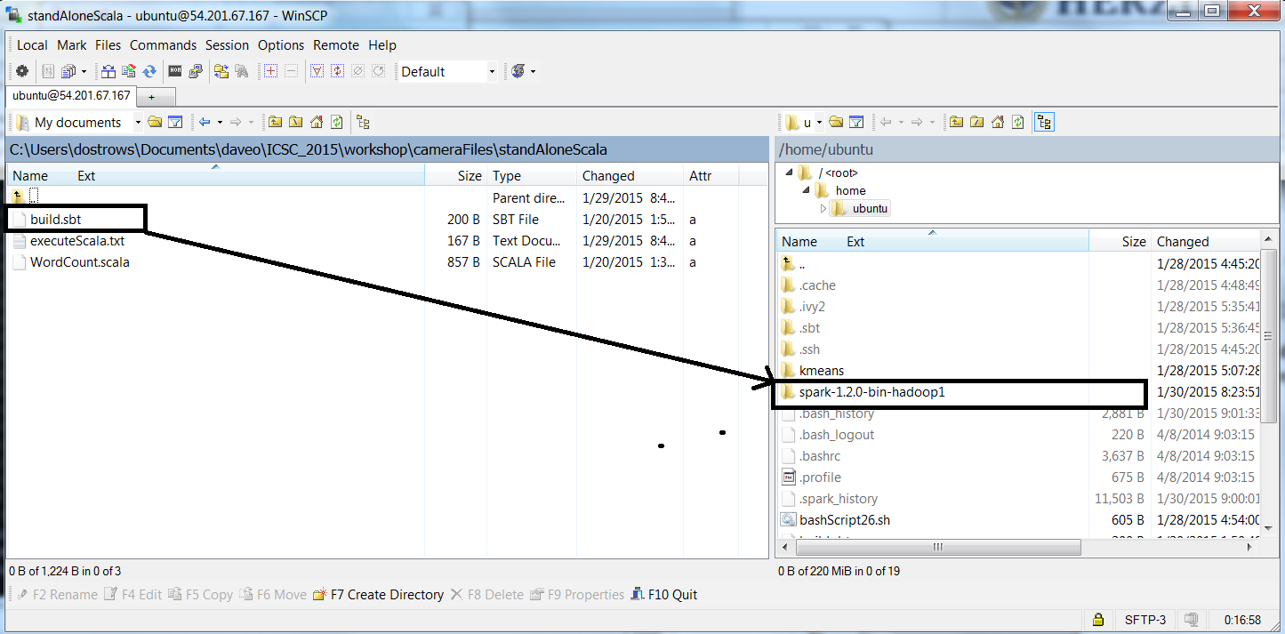
Standalone Spark sbt build file copy

Slide 13
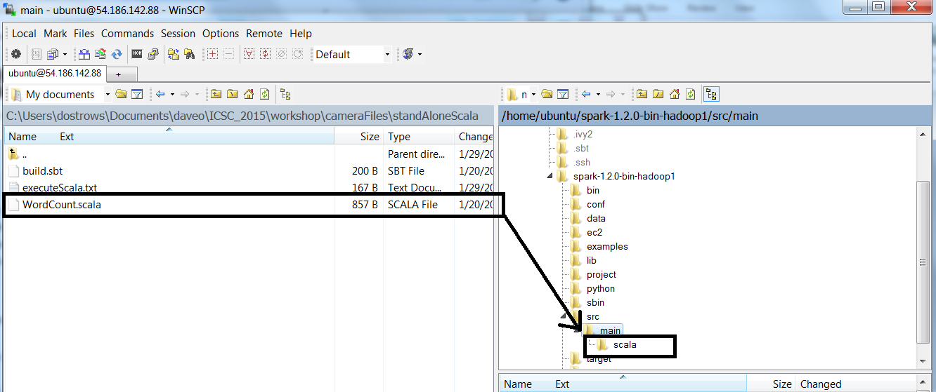
Standalone Spark WordCount.scala copy

Slide 14
Standalone Applications in Spark
Step 2: perform the build : Commands are
ubuntu@ip-172-31-11-96:~/spark-1.2.0-bin-hadoop1$ sbt clean compile package
Step 3 : standalone execution:
ubuntu@ip-172-31-11-96:~/spark-1.2.0-bin-hadoop1$ bin/spark-submit --class com.oreilly.learningsparkexamples.mini.scala.WordCount target/scala-2.10/learning-spark-mini-example_2.10-0.0.1.jar README.md wordcounts

Slide 15
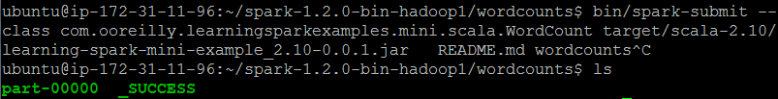
Standalone Spark Implementation
Output from this will reside in the wordcounts directory
Below is the part file

Slide 16
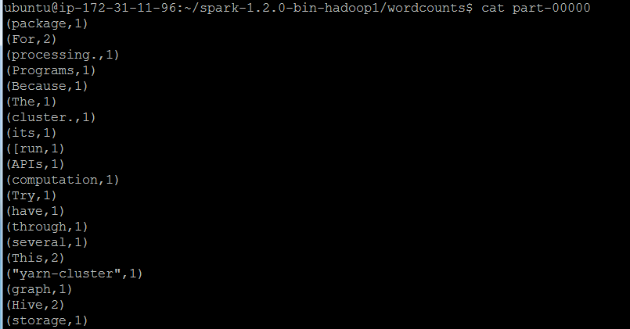
Standalone Spark Implementation
Output from this will reside in the wordcounts directory
Contents of the part file (below)

Slide 17
Spark Streaming
Many applications benefit from acting on data as soon as it arrives.
Applications might track statistics about page views in real time, train a machine learning model or automatically detect anomalies.
It lets users write streaming applications using a very similar API to batch jobs and thus reuse a lot of the skills and even code used.

Slide 18
Spark Streaming
Spark Streaming provides an abstraction called Dstreams or discretized streams.
A Dstream is a sequence of data arriving over time.
Each Dstream is represented as a sequence of RDDs arriving at each time step.
Dstreams can be created from various input data sources, such as Flume , Kafka or HDFS
Once built, they offer two types of operations: transformations, which yield a new Dstream and output operations which write data to an external system.

Slide 19
Spark Streaming
Spark Streaming programs are best run as standalone applications, built using Maven or SBT.
There is a prebuilt Spark Streaming example which does not work to the online documentation - so I made a similar version that is able to successfully work
We will be leveraging the work on the application build from the last example – for brevity, we will be relying on as much from the last example (including naming the file “wordCount” in order to use the same application build file)
We will be using two putty terminals in a client/server mode to our single amazon instance
The client will be where we input data in real time
The server will run our scala program which will received the input

Slide 20
Spark Streaming
How will this work?
To demonstrate better how the stream will work , please note that you can run a client / server application on the same machine , in this case, using a port address to send data between the two
For example I can start two putty terminals to my amazon instance

Slide 21
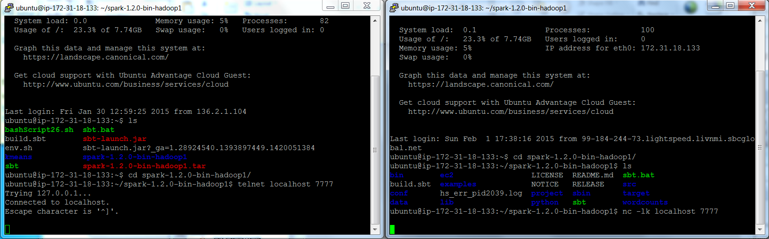
Spark Streaming quick demonstration of client / server between terminals
The client: nc -lk localhost 7777
The Sever: $telnet localhost 7777

Slide 22
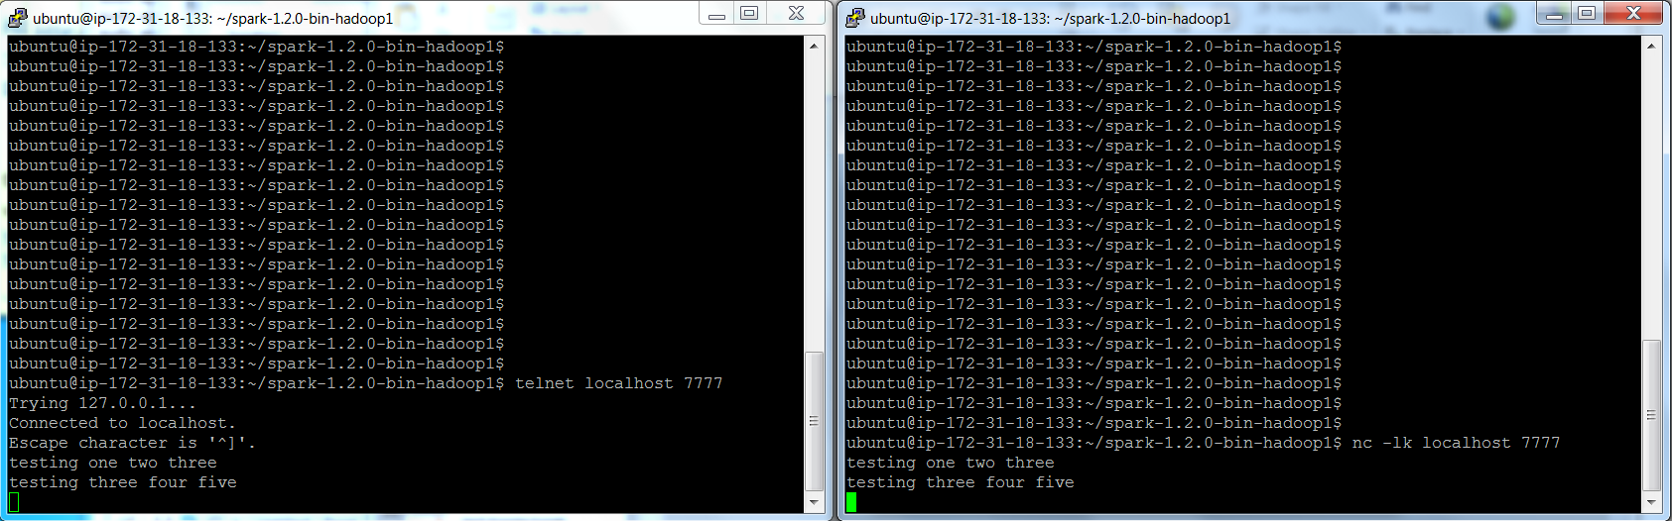
Spark Streaming demonstration of client / server between terminals
Here, it passes from a client to the server (input from one terminal and prints it out from the other terminal)

Slide 23
Spark Streaming Example
Step one : copy “wordcount.scala” example program from streaming IO folder to /src/main/scala in the spark home
This is overlaying the workcount program and thus we are creating the streaming program as another standalone application
To do so we are going to keep the same name
ubuntu@ip-172-31-44-254:~/spark-1.2.0-bin-hadoop1$

Slide 24
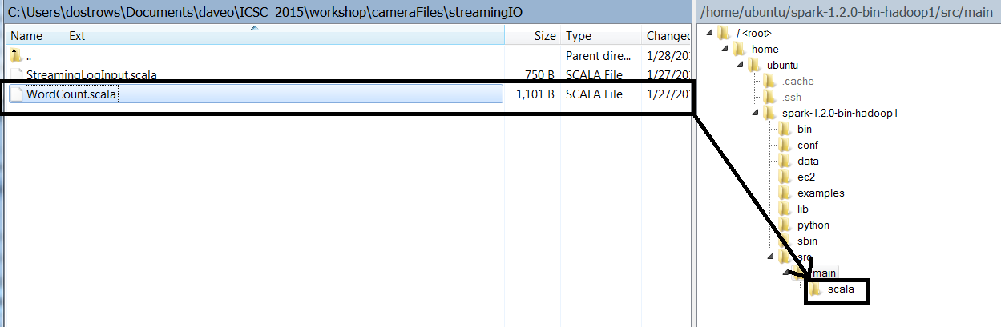
Spark Streaming Example
Step one :copy WordCount.scala from (this time) “streamingIO” to /spark-1.2.0-bin/src/main/scala

Slide 25
Spark Streaming Example
Step two : perform a build (again, relying on the spark application build example)
Step three : start a second (putty) terminal to your amazon instance -this will be used for the client
Step four: enter the commands as identified for the client (you will be entering streaming text from one terminal and using the streaming application from the second to read it.)
Step five: start the server in the original terminal and enjoy

Slide 26
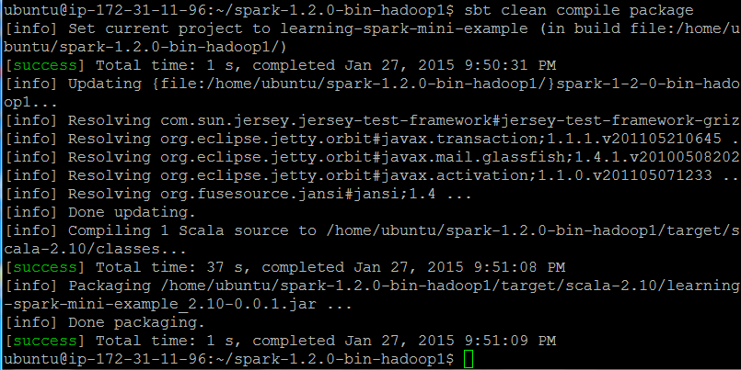
Spark Streaming Example
sbt clean compile package

Slide 27
Spark Streaming Example
Run the server in one terminal (from spark home directory)
Note: the “local[4]” is the number of parallel tasks.
bin/spark-submit --class com.oreilly.learningsparkexamples.mini.scala.WordCount target/scala-2.10/learning-spark-mini-example_2.10-0.0.1.jar local[4]
Run the client as before
nc -lk localhost 7777

Slide 28
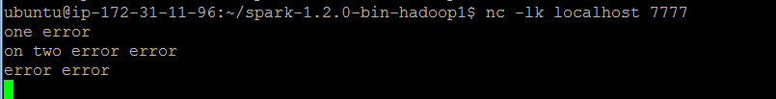
Spark Streaming Example
Start the client

Slide 29
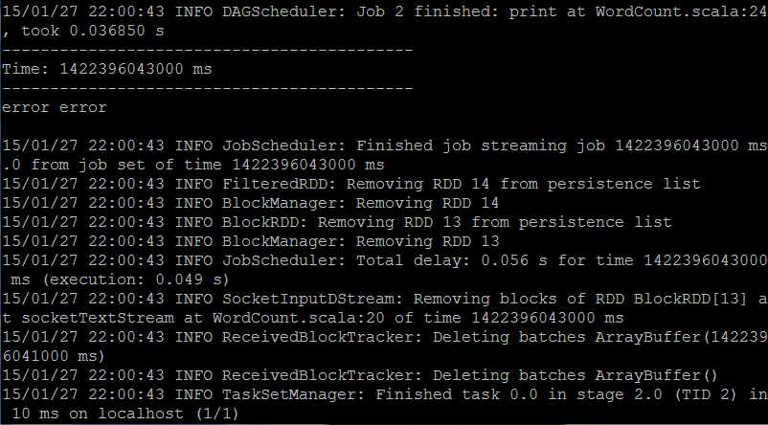
Spark Streaming Example
The streaming server starting…..

Slide 30
Spark Streaming Example (entire)
package com.oreilly.learningsparkexamples.mini.scala
import org.apache.spark.streaming.StreamingContext
import org.apache.spark.streaming.StreamingContext._
import org.apache.spark.streaming.dstream.DStream
import org.apache.spark.streaming.Duration
import org.apache.spark._
import org.apache.spark.SparkContext._
object WordCount {
def main(args: Array[String]) {
val conf = new SparkConf().setMaster("local[2]").setAppName("NetworkWordCount")
// Create a StreamingContext with a 1-second batch size from a SparkConf
//val ssc = new StreamingContext(conf, Seconds(1))
val ssc = new StreamingContext(conf,Duration(1000)) //, 1.seconds())
// Create a DStream using data received after connecting to port 7777 on the local machine
val lines = ssc.socketTextStream("localhost", 7777)
// Filter our DStream for lines with "error"
val errorLines = lines.filter(_.contains("error"))
// Print out the lines with errors
errorLines.print()
// Start our streaming context and wait for it to "finish"
ssc.start()
// Wait for the job to finish
ssc.awaitTermination( }}

Slide 31
Spark Streaming breakdown of code
// load in the libraries
package com.oreilly.learningsparkexamples.mini.scala
import org.apache.spark.streaming.StreamingContext
import org.apache.spark.streaming.StreamingContext._
import org.apache.spark.streaming.dstream.DStream
import org.apache.spark.streaming.Duration
import org.apache.spark._
import org.apache.spark.SparkContext._

Slide 32
Spark Streaming
We start by creating a StreamingContext, which is the main entry point for streaming functionality.
This also sets up an underlying SparkContext that it will use to process the data.
It takes as input a batch interval specifying how often to process new data which we set to 1 second.

Slide 33
Spark Streaming
object WordCount {
def main(args: Array[String]) {
val conf = new SparkConf().setMaster("local[2]").setAppName("NetworkWordCount")
// Create a StreamingContext with a 1-second batch size from a SparkConf
//val ssc = new StreamingContext(conf, Seconds(1))
val ssc = new StreamingContext(conf,Duration(1000)) //, 1.seconds())

Slide 34
Spark Streaming
Then socketTextStream is used to create a Dstream based on text data received on port 7777 of the local machine
Then we transform the Dstream with filter to get only the lines that contain “error”
Finally , we apply the output operation print to print some of the filtered lines

Slide 35
Spark Streaming
// Create a DStream using data received after connecting to port 7777 on the local machine
val lines = ssc.socketTextStream("localhost", 7777)
// Filter our DStream for lines with "error"
val errorLines = lines.filter(_.contains("error"))

Slide 36
Spark Streaming
// Print out the lines with errors
errorLines.print()
// Start our streaming context and wait for it to "finish"
ssc.start()
// Wait for the job to finish
ssc.awaitTermination()
}
}

Slide 37
Spark / Mlib
Mlib is a machine learning toolkit/ library built in Spark
No extra packages it is self-contained
Allowing for functionality similar in nature to Mahout – but faster and less code to manage

Slide 38
Spark/ Mlib (kmeans)
To run the example, you will go back to simply copying code from the MLIB directory back into the spark-shell interpretive prompt
The data files are included in the MLIB distribution so they are already there.
The first example is the kmeans so open the kmeans file under MLIB and copy into the interpretive prompt.

Slide 39
Spark/ Mlib (kmeans)
import org.apache.spark.mllib.clustering.Kmeans
import org.apache.spark.mllib.linalg.Vectors
val data = sc.textFile("data/mllib/kmeans_data.txt")
val parsedData = data.map(s => Vectors.dense(s.split(' ').map(_.toDouble)))
val numClusters = 2
val numIterations = 20
val clusters = KMeans.train(parsedData, numClusters, numIterations)
// Evaluate clustering by computing Within Set Sum of Squared Errors
val WSSSE = clusters.computeCost(parsedData)
println("Within Set Sum of Squared Errors = " + WSSSE)

Slide 40
Spark/ Mlib (kmeans)
In the following example after loading and parsing data
the KMeans object to cluster the data into two clusters
The number of desired clusters is passed to the algorithm.
We then compute Within Set Sum of Squared Error (WSSSE)

Slide 41
Spark/ Mlib (kmeans)
Input data:
ubuntu@ip-172-31-44-254:~/spark-1.2.0-bin-hadoop1$ cat data/mllib/kmeans_data.txt
0.0 0.0 0.0
0.1 0.1 0.1
0.2 0.2 0.2
9.0 9.0 9.0
9.1 9.1 9.1
9.2 9.2 9.2

Slide 42
Linear regression with Stochastic Gradient Descent (reference SGD in MLIB folder)
import org.apache.spark.mllib.regression.LinearRegressionWithSGD
import org.apache.spark.mllib.regression.LabeledPoint
import org.apache.spark.mllib.linalg.Vectors
// Load and parse the data: ans, features
val data = sc.textFile("data/mllib/ridge-data/lpsa.data")
val parsedData = data.map { line =>
val parts = line.split(',')
LabeledPoint(parts(0).toDouble, Vectors.dense(parts(1).split(' ').map(_.toDouble)))
}.cache()

Slide 43
Linear regression with Stochastic Gradient Descent continued.
// Building the model
val numIterations = 100
val model = LinearRegressionWithSGD.train(parsedData, numIterations)
// Evaluate model on training examples and compute training error
val valuesAndPreds = parsedData.map { point =>
val prediction = model.predict(point.features)
(point.label, prediction)
}
val MSE = valuesAndPreds.map{case(v, p) => math.pow((v - p), 2)}.mean()
println("training Mean Squared Error = " + MSE)

Slide 44
Spark MLIB decision tree example
import org.apache.spark.mllib.tree.DecisionTree
import org.apache.spark.mllib.util.MLUtils
// Load and parse the data file.
val data = MLUtils.loadLibSVMFile(sc, "data/mllib/sample_libsvm_data.txt")
// Split the data into training and test sets (30% held out for testing)
val splits = data.randomSplit(Array(0.7, 0.3))
val (trainingData, testData) = (splits(0), splits(1))
// Train a DecisionTree model.
// Empty categoricalFeaturesInfo indicates all features are continuous.
val numClasses = 2
val categoricalFeaturesInfo = Map[Int, Int]()
val impurity = "gini"
val maxDepth = 5
val maxBins = 32

Slide 45
Spark MLIB decision tree example decisiontree.txt)
val model = DecisionTree.trainClassifier(trainingData, numClasses, categoricalFeaturesInfo,
impurity, maxDepth, maxBins)
// Evaluate model on test instances and compute test error
val labelAndPreds = testData.map { point =>
val prediction = model.predict(point.features)
(point.label, prediction)
}
val testErr = labelAndPreds.filter(r => r._1 != r._2).count.toDouble / testData.count()
println("Test Error = " + testErr)
println("Learned classification tree model:\n" + model.toDebugString)

Slide 46
Spark GraphX
GraphX is the new spark API for graphs and graph-parallel computation
GraphX extends the Spark RDD by introducing the Resilient Distributed Property Graph
To support graph computation, GraphX exposes a set of fundamental operators
They will be executed by copying the examples from the files (copy to spark interpretative prompt)

Slide 47
Spark GraphX
Bring in the libraries
import org.apache.spark._
import org.apache.spark.graphx._
// To make some of the examples work we will also need RDD
import org.apache.spark.rdd.RDD

Slide 48
Spark GraphX (removeBrokenLinks.txt)
val users: RDD[(VertexId, (String, String))] =
sc.parallelize(Array((3L, ("rxin", "student")), (7L, ("jgonzal", "postdoc")),
(5L, ("franklin", "prof")), (2L, ("istoica", "prof")),
(4L, ("peter", "student"))))
// Create an RDD for edges
val relationships: RDD[Edge[String]] =
sc.parallelize(Array(Edge(3L, 7L, "collab"), Edge(5L, 3L, "advisor"),
Edge(2L, 5L, "colleague"), Edge(5L, 7L, "pi"),
Edge(4L, 0L, "student"), Edge(5L, 0L, "colleague")))
// Define a default user in case there are relationship with missing user
val defaultUser = ("John Doe", "Missing")

Slide 49
Spark GraphX remove broken links (pt 2)
// Build the initial Graph
val graph = Graph(users, relationships, defaultUser)
// Notice that there is a user 0 (for which we have no information) connected to users
// 4 (peter) and 5 (franklin).
graph.triplets.map(
triplet => triplet.srcAttr._1 + " is the " + triplet.attr + " of " + triplet.dstAttr._1
).collect.foreach(println(_))
// Remove missing vertices as well as the edges to connected to them
val validGraph = graph.subgraph(vpred = (id, attr) => attr._2 != "Missing")
// The valid subgraph will disconnect users 4 and 5 by removing user 0
validGraph.vertices.collect.foreach(println(_))
validGraph.triplets.map(
triplet => triplet.srcAttr._1 + " is the " + triplet.attr + " of " + triplet.dstAttr._1
).collect.foreach(println(_))

Slide 50
Spark GraphX average age example
import org.apache.spark.graphx.util.GraphGenerators
// Create a graph with "age" as the vertex property. Here we use a random graph for simplicity.
val graph: Graph[Double, Int] =
GraphGenerators.logNormalGraph(sc, numVertices = 100).mapVertices( (id, _) => id.toDouble )
// Compute the number of older followers and their total age
val olderFollowers: VertexRDD[(Int, Double)] = graph.mapReduceTriplets[(Int, Double)](
triplet => { // Map Function
if (triplet.srcAttr > triplet.dstAttr) {
// Send message to destination vertex containing counter and age
Iterator((triplet.dstId, (1, triplet.srcAttr)))
} else {
// Don't send a message for this triplet
Iterator.empty
}
},
// Add counter and age
(a, b) => (a._1 + b._1, a._2 + b._2) // Reduce Function
)

Slide 51
Spark GraphX
// Divide total age by number of older followers to get average age of older followers
val avgAgeOfOlderFollowers: VertexRDD[Double] =
olderFollowers.mapValues( (id, value) => value match { case (count, totalAge) => totalAge / count } )
// Display the results
avgAgeOfOlderFollowers.collect.foreach(println(_))

Slide 52
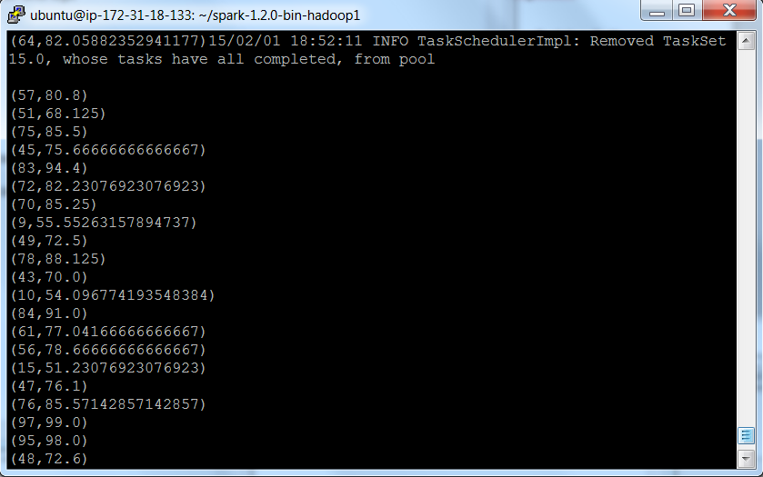
Spark GraphX

Slide 53
Spark GraphX
import org.apache.spark.graphx._
// Import random graph generation library
import org.apache.spark.graphx.util.GraphGenerators
// A graph with edge attributes containing distances
val graph: Graph[Int, Double] =
GraphGenerators.logNormalGraph(sc, numVertices = 100).mapEdges(e => e.attr.toDouble)
val sourceId: VertexId = 42 // The ultimate source
// Initialize the graph such that all vertices except the root have distance infinity.
val initialGraph = graph.mapVertices((id, _) => if (id == sourceId) 0.0 else Double.PositiveInfinity)

Slide 54
Spark GraphX single source shortest path
val sssp = initialGraph.pregel(Double.PositiveInfinity)(
(id, dist, newDist) => math.min(dist, newDist), // Vertex Program
triplet => { // Send Message
if (triplet.srcAttr + triplet.attr < triplet.dstAttr) {
Iterator((triplet.dstId, triplet.srcAttr + triplet.attr))
} else {
Iterator.empty
}
},
(a,b) => math.min(a,b) // Merge Message
)
println(sssp.vertices.collect.mkString("\n"))

Slide 55
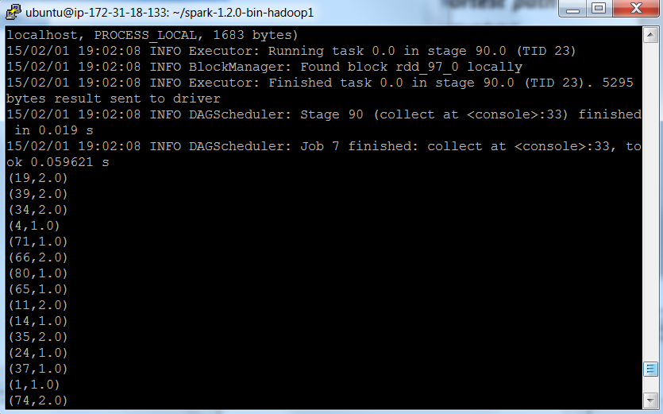
Spark GraphX single source shortest path
val sssp = initialGraph.pregel(Double.PositiveInfinity)(
(id, dist, newDist) => math.min(dist, newDist), // Vertex Program
triplet => { // Send Message
if (triplet.srcAttr + triplet.attr < triplet.dstAttr) {
Iterator((triplet.dstId, triplet.srcAttr + triplet.attr))
} else {
Iterator.empty
}
},
(a,b) => math.min(a,b) // Merge Message
)
println(sssp.vertices.collect.mkString("\n"))

Slide 56

Future of Big Data
Storm
Apache (incubator project)
Utilizes the Clojure programming language
Open sourced after acquired by Twitter
Uses custom created “spouts” and “bolts” to define information source to allow batch , distributed processing of streaming data

Slide 57
Hadoop vs Storm
Hadoop Storm
Batch processing Real-time processing
Jobs run to completion topologies run forever
Stateful nodes stateless nodes
Scalable scalable
Guarantees no data loss guarantees no data loss
Open source open source
Big b atch processing fast, reactive, real time processing

Slide 58

Q/A
dostrows@ford.com
www.linkedin.com/pub/david-ostrowski/9/97a/29b

Slide 59
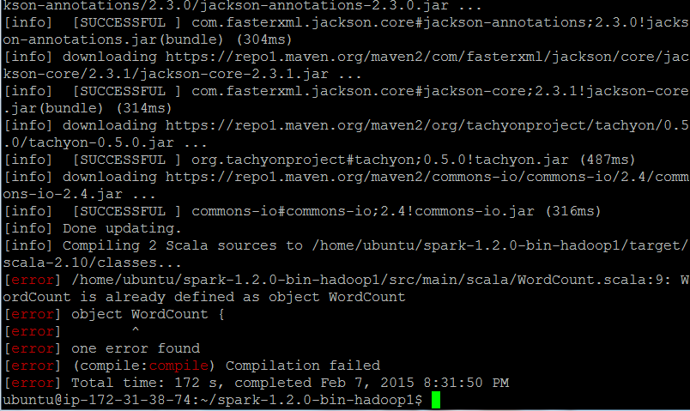
Appendix A:Troubleshooting Guide
Compile error (extra copy of WordCount.scala inadvertently copied in the spark home directory – delete it!)

Slide 60

Troubleshooting guide.
To eloquently leave the spark interpretive prompt, you need to enter sys.exit vs a control <key character> which can ultimately result in a memory error.

